Slide 1


Using a PSO to Build an Even Safer Healthcare System
PSOs and Healthcare Providers Advancing Patient Safety
NPSF Webinar
June 23, 2016

Slide 2
Speakers
Lisa Mead RN,MS, CPHQ
  Director Quality and Safety, Strategic Radiology PSO
Peggy Binzer Esq
  Executive Director, Alliance for Quality Improvement and Patient Safety

Slide 3
AQIPS
National Professional Association of Patient Safety Organizations (PSOs) and their provider members, whose mission is to fosters the ability of PSOs and providers to implement a safety culture to produce high reliable, quality care for the benefit of patients through the use of the Patient Safety Act’s privilege and confidentiality protections.
PSOs and Healthcare Providers Advancing Patient Safety

Slide 4
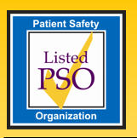
Strategic Radiology PSO
Listed 2013, Relisted 2016
25 Radiology Practice Providers
  1,500 Radiologists
  Annual Interpretations: (Approx. 10% of overall radiology care provided nationally)
    20,000,000 Diagnostic Imaging
    240,000 Nuclear Medicine
    450,000 Vascular & Interventional Radiology Procedures
  534 Outpatient Imaging Centers
  122 Hospitals

Slide 5
Objectives
Discover the benefits of working with a Patient Safety Organization, including best practices.
Learn how to meet the requirements of section 1311(h) of the Affordable Care Act and the Merit-Based Incentive Payment System (MIPS).
Create a learning system to prevent the same mistakes from being repeated by other healthcare professionals.
Learn to use a PSES with integrated care models and new quality performance data tools.
Use a PSES to create high-reliability in healthcare.

Slide 6
Impetus for the Patient Safety and Quality Improvement Act of 2005
As many as 98,000 patients die each year as a result of medical errors. To Err is Human, Institute of Medicine, 1999.
Intended to be the NTSB/ARAS system for healthcare – to provide immunity to licensed provider who report errors or patient harm.
Many states’ peer review protections have been eroded, the protections do not cross state lines, and are generally inadequate for the purpose of sharing information to promote patient safety.
Protections to implement Safety Culture and learning systems: Congress intended that interventions, protocols, information about best practices, and systems improvements that are developed through the analysis of patient safety work product be shared by providers and PSOs to enable patient safety improvements to occur throughout the health care delivery system.

Slide 7
Only Program that Allows Providers to Evaluate How They are Doing
“PSOs are the only program that permit health care providers to investigate how they are providing patient care and how they can do a better job without fear of litigation or harm to professional reputation. Many QI and safety programs look only at the what, whereas a PSO can help health care professionals figure out the how, in a safety culture that reinforces professionalism and learning, to the benefit of patients. ”
              Angie Skretta, NorMet PSI

Slide 8

The “Alphabet Soup” of the PSQIA
PSO
Patient Safety Organization
PSES
Patient Safety Evaluation System
PSWP
Patient Safety Work Product
PSQIA
Patient Safety and Quality
Improvement Act of 2005,
Patient Safety Act

Slide 9
Patient Safety Organization
Self-certifying experts listed by AHRQ as qualified organizations whose mission and primary purpose are to conduct analysis and provide feedback aimed at improving patient safety and the quality of healthcare delivery.
Can be a part of a health system or other provider entity
Can be for a certain specialty or registry
Can be part of a professional association

Slide 10
Patient Safety Evaluation System (PSES)
  The collection, management, or analysis of confidential information for reporting to or by a PSO.
  Clinical Prospective: Where providers can evaluate how they improve upon the high quality job they are doing.
  Legal Prospective: Identifies protected information and protected space.
  “These protections will enable all health care systems, including multi-facility health care systems, to share data within a protected legal environment, both within and across states, without the threat that the information will be used against the subject providers”. PSA final Rule

Slide 11
Patient Safety Work Product
Any data, reports, records, memoranda, analysis (such as root cause analysis), or written or oral statements which are:
assembled or developed by a provider for reporting to a patient safety organization and are reported to a patient safety organization or
developed by a PSO
  and which could result in improved patient safety, health care quality, or health care outcomes or
which identify or constitute the deliberations or analysis of a patient safety evaluation system.

Slide 12
Patient Safety Work Product
Patient Safety Work Product is NOT –
Original records – medical records, billing records
PSWP does not include information that is collected, maintained, or developed separately, or exists separately, from a patient safety evaluation system (e.g., required to be reported to the state or needed for oversight under the Conditions of Participation).

Slide 13
Few Limits for the PSO Protections
Thinking Inside the Box
Administrative practices, e.g., billing,
Mandatory Report to State
Communications among providers; Peer Review; Coordinating care; missed or delayed diagnosis analysis; Gap or Systems Analysis; laboratory testing review; convenings; surveys; real time monitoring by the PSO; scorecards; clinical protocol development; FMEA; peer meetings; case studies; bench marking; safety culture surveys; dashboards; predictive and statistical analysis; analysis of quality indicators; root cause analysis; peer conversations; quality meetings; real time analysis of errors; near misses; interviews; reports; additional information from incident reports; PSO takes the signals and investigates/evaluates; trigger tool; patient registries; employee or visitor injury related to patient safety; utilization; drug adherence; transfer gaps; medical necessity review; second victim counseling; outcomes analysis; Committee agendas, minutes and reports; recommendations; best practices; surveys among providers; informal consults; interdisciplinary conference that is educational in nature; development of clinical guidelines;
Facts in the medical record or from interviews
HIPAA: Written information relied upon for treatment decisions
Criminal Activity

Slide 14
PSWP Privilege Protections
  Provides federal liability protections to providers:
    Federal privilege and confidentiality protections cross state lines
    Establishes a federal peer review privilege for all licensed providers (e.g., primary care physicians, pharmacists)
    Preempts use of protected information in federal cases (e.g., racial discrimination)
    Stronger and broader than any state peer privilege

Slide 15
PSES Protections Go Where State Peer Statutes Do Not
Innovative health care delivery systems– integrated models (ACO), physician alignment (CIN)
New performance assessments – outcomes, quality measures, modified peer review in ambulatory care
Performance assessment tools (physician score cards, dashboards)
Systemizing care for high reliability (surveillance peer systems, checklists and clinical guidelines)
Need for transparency among affiliated and unaffiliated healthcare providers (Learning system across hospitals/ambulatory care, including across state lines)
Assess Gaps in coordination of chronic care

Slide 16
Protections to Empower Healthcare Providers to Implement Safety Culture
Confidentiality (HIPAA for Providers)– The Act places a statutory requirement on providers not to disclose “Patient Safety Work Product,” except under certain circumstances and imposes penalties of up to $11,000 per violation against any person or principal who knowingly or recklessly violates the confidentiality provisions.
Disclosure Permissions – To share the good information.
Whistleblower – No disciplinary action for reporting.
“The single greatest impediment to error prevention in the medical industry is that we punish people for making mistakes.”
- Lucian Leape

Slide 17
Protections for the PSO
A PSO Cannot be Compelled: A patient safety organization cannot be compelled to disclose information collected or developed whether or not such information is patient safety work product unless the court or government can:
  Identify the specific information,
  Prove the information Is not patient safety work product, and
  Show they cannot reasonably available from another source.
The exception is for a criminal action

Slide 18
Case Example
Health system/ACO/CIN establishes ER stroke protocol with target response time
Participants train staff on protocol
Participants each report on performance measures
Staff identifies potential systems issue at one facility (problem or excellence)
Peer review is performed in the PSES and is considered “analysis” that is PSWP. (PSWP can be disclosed to the PSO for greater analysis and dissemination of best practices.)

Slide 19
High Reliability of Care: New Transparency in Health Care
Establish clinical guidelines and best practices
Collect data by each facility
Review for Quality
Validate findings and best practices
Share data (reactive to proactive)
Raise standards through system-wide learning

Slide 20
ACA PSO Mandates
CMS Proposed Rule on PSES
All hospitals over 50 beds must have a PSES by 2017 to participate in exchanges.
Final Rule in March: Must have an evidence-based initiative, to improve health care quality through the collection, management and analysis of patient safety events that reduces all cause preventable harm, prevents hospital readmission, or improves care coordination.
Implementation January 1, 2017

Slide 21
Patient Safety Issues
  Physician practices have issues about which far less is known than in hospitals
  Adverse events and near misses: drug interactions, drug mismanagement, etc.
  Missed diagnoses
  Failure to report abnormal test results
  Patient misunderstanding of instructions, and more…
  Defensive medicine is part of the problem, but not much (2.4% of health care expenditures overall)

Slide 22
PSO Benefits
  Collaborative, Safe Environment
  Learning Environment
  Aggregation of Safety & Quality Data
  Protect Dose Monitoring Data
  Demonstrate commitment to quality and safety
  Radiology industry leadership opportunity
  Identify opportunities to avoid incidents and adverse events
  Allow Peer Review to operate across state lines with added protection
  Subspecialized Forums

Slide 23
Augmenting Current Efforts
  Facilitate evidence based performance for groups and individuals
  Create quality metric dashboards
  Identify and facilitate process improvement opportunities
  Develop programs for provision of patient care
  Develop “best practices” for the provision of care and services
    Lung Cancer Screening
    Thyroid Biopsy
    Protocols
    Policies and procedures

Slide 24
Augmenting Current Efforts
  Host an bi-annual quality and safety conference.
  Leverage the power of aggregated data.
  Assist in driving practice trends.
  SR PSO quality data sharing will change practices and processes.
  Group will adopt standards developed by the collective groups (SR).
  Improve organizational infrastructure for smaller groups.
  Offer Quality Consultation support
  Your PSO can be an extension of your organization’s safety and quality staff and resources.

Slide 25
Benefits of Working with a PSO
Convening Safe Tables
Open Discussions
Shared Learnings
Collation and Analysis of data
Policy Sharing
Development of Best practices
Understand and prevent future adverse events

Slide 26
What is a Safe Table?
PSO members only shared learning meeting held between radiologist peers and quality &safety professionals to discuss patient safety and quality issues in the radiology sector.
Discussions are held in an uninhibited, safe and confidential manner.
Led by PSO workforce.

Slide 27
Open Discussions
  Adverse Events
  Peer Review
  Success Stories
  Challenges

Slide 28
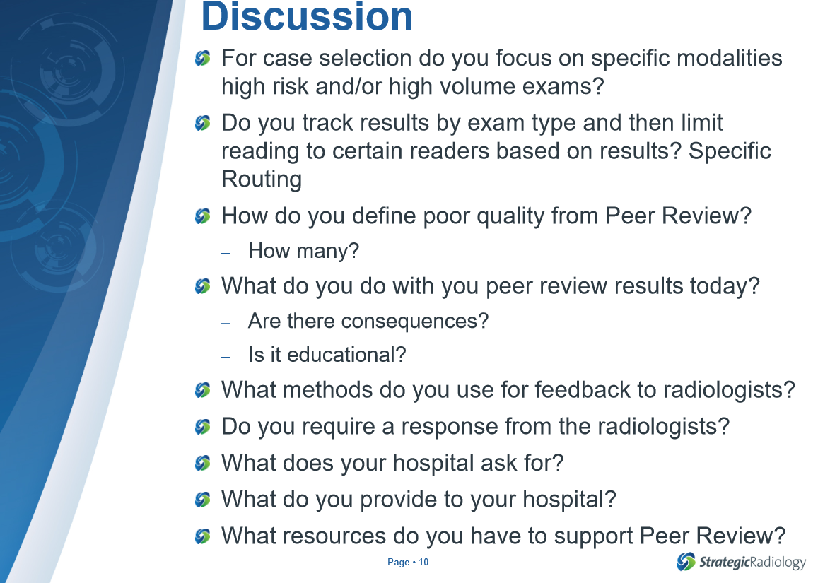
Examples

Slide 29
Shared Learning
Presentations:
  Physician Performance Reports
  Case Reviews
  Metrics Reviews
  Technologist Quality
  Peer Review

Slide 30

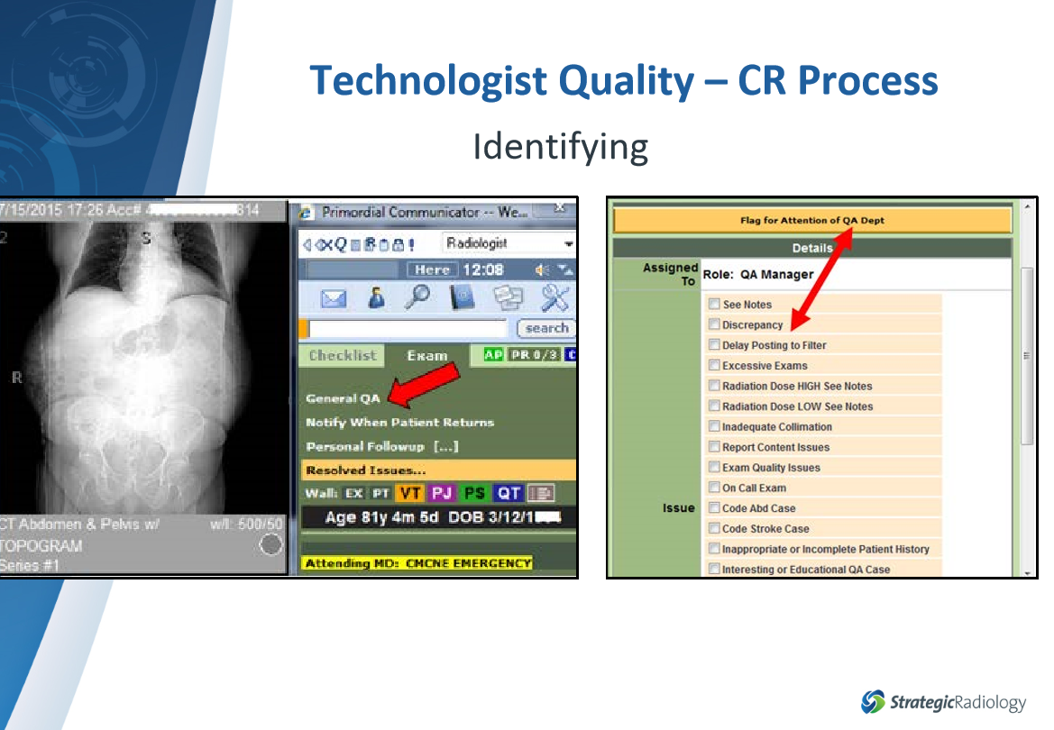
Examples

Slide 31
Standards Created
Managing Critical Results, Non-Critical but significant and Incidental Findings
Role of Physician Extenders (PA’s, NP’s, RPA’s)
Lung Cancer Screening Program
Program Standards:
    Report Turnaround Time
    Code Stroke Call Back for CT
    Peer Review
    Call Back Rates

Slide 32
Additional Deliverables
Clinical Quality Report
Dose Optimization and unified vendor
Peer Review Pilot Sub-specialty Program
Adverse and Event Reporting System
PQRS
Facilitated Workgroups:
  Demonstrating Value
  Enhancing Culture of Safety
  Enhancing Customer Satisfaction
  Eliminating Waste
  Utilization Management
  Standardization

Slide 33
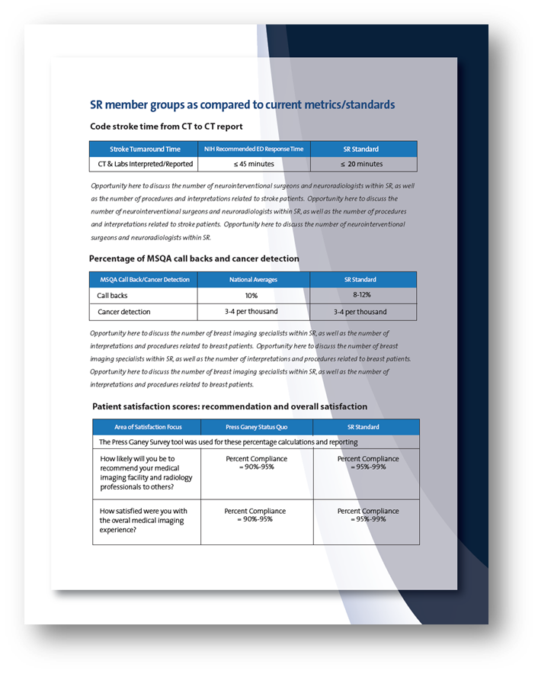

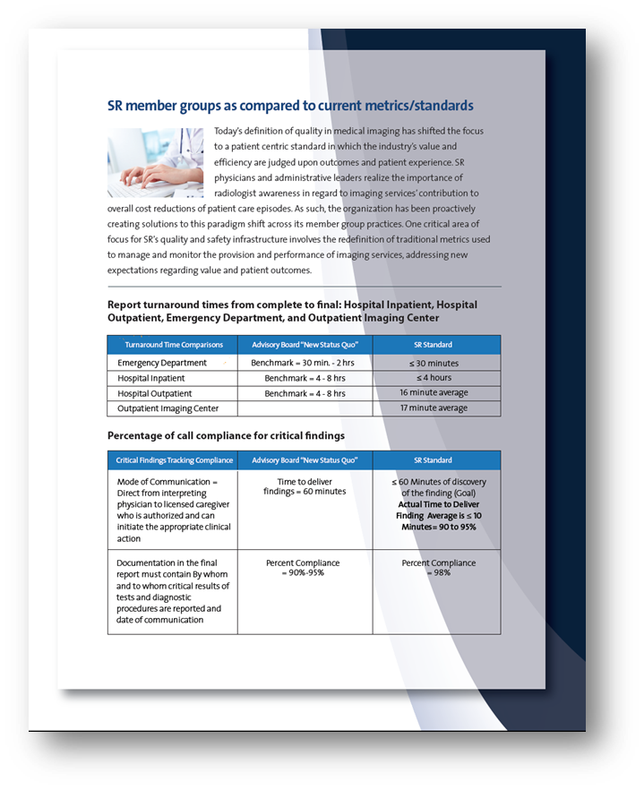
Quality Report
SR standards for turnaround times, patient satisfaction, critical results, MSQA call backs and detection, stroke CT to report times

Slide 34
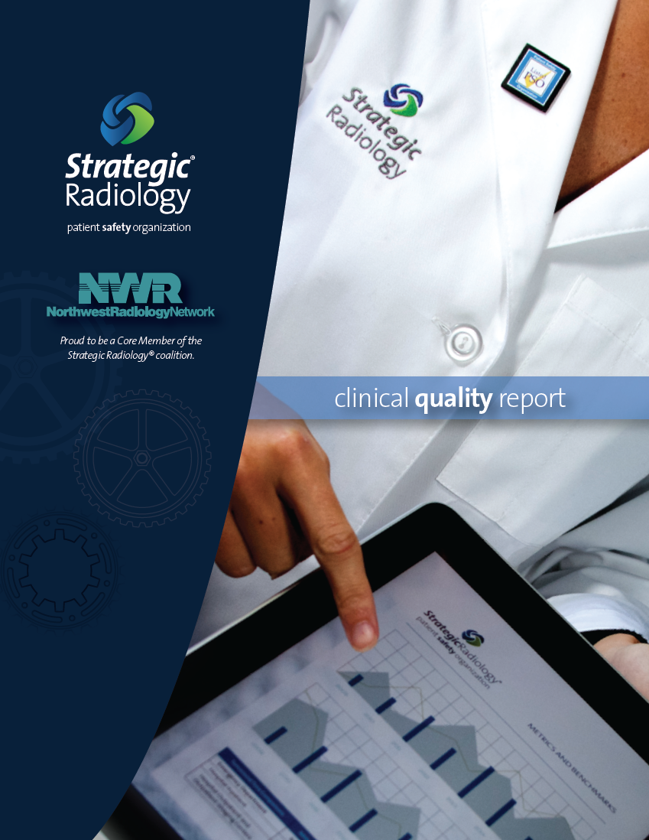

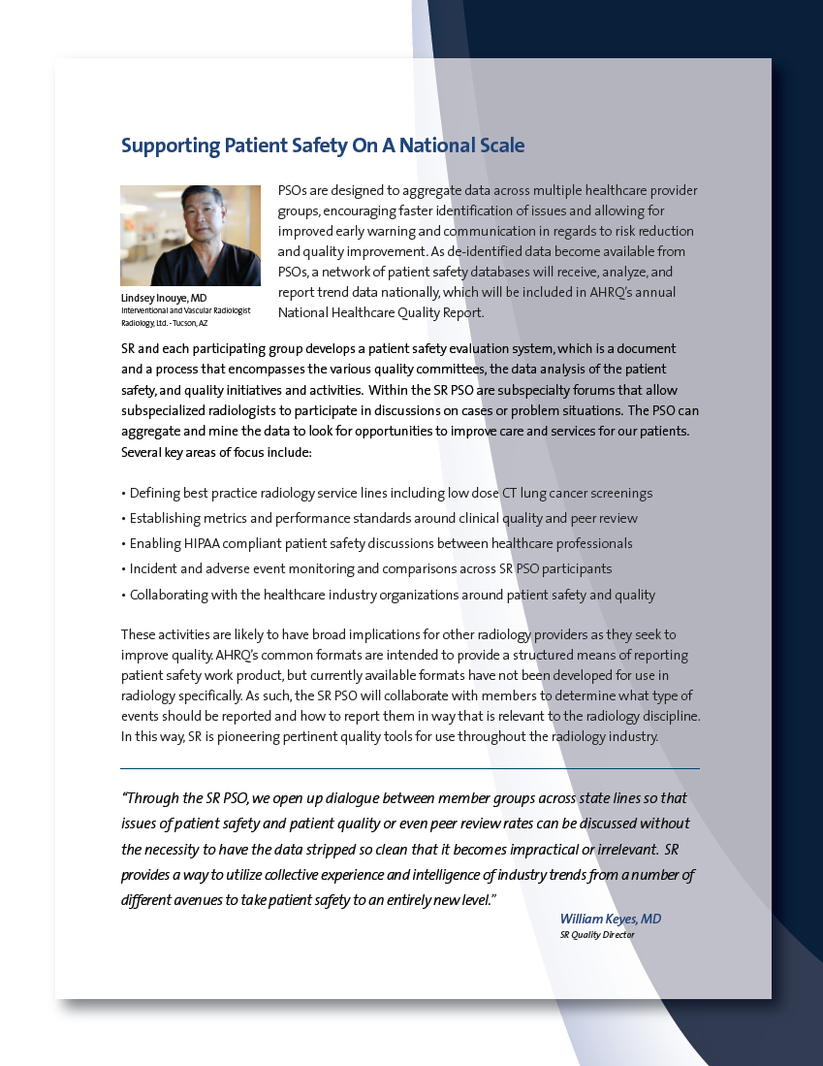
Available for customization
Logo on cover
Physician photos
Call out quotes

Slide 35

SR PSO Up2Date News
“This experience was a wake up call. I need to bring a fully comprehensive quality program to my group. I have no doubt the experience of SR member groups will be an invaluable and available guide.”

Slide 36
Questions?

